Slide 1

BOOKS RECOMMENDATION SYSTEM
By Abhay Maurya

Slide 2


Project Overview
This project combines a simple yet interactive frontend built with HTML and a backend using Python, Flask, and machine learning algorithms.
The aim is to provide users with book recommendations based on the book title they input.

Slide 3
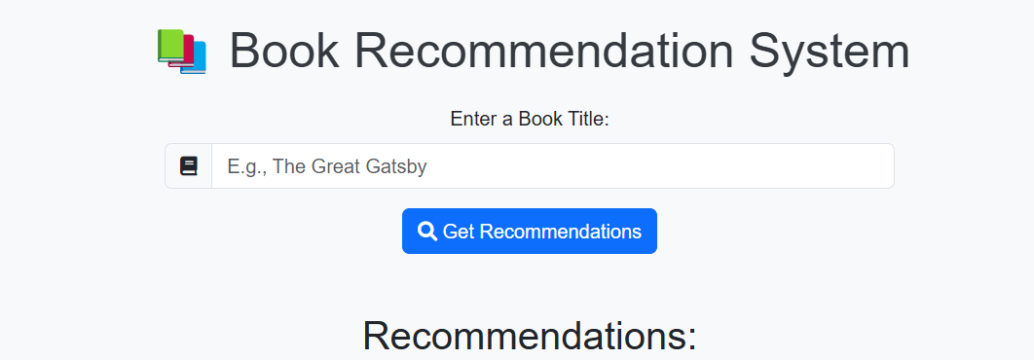
Frontend Design
Snapshot
For the frontend, I used a responsive HTML form where users can enter a book title.
Upon submission, the form interacts with the backend API to fetch recommendations.
I enhanced the UI with Bootstrap for responsiveness and added features like a loading spinner and styled recommendation cards for a better user experience.

Slide 4
Backend Implementation
The backend is powered by Flask. Here's how it works:
The application loads and preprocesses a dataset of books.
Using scikit-learn's NearestNeighbors algorithm, I trained a model to find books similar to the one the user inputs.
The API handles requests, matches the input title, and returns recommendations in real time.
The backend ensures fast and accurate responses while maintaining a simple architecture.

Slide 5
Dataset and Preprocessing
I used a dataset containing information about books, including their titles, ratings, and languages.
First, I added rating categories to group books by average ratings.
I used one-hot encoding for categorical features like the rating range and language.
To normalize the data, I applied MinMaxScaler, ensuring all features had comparable ranges.
These preprocessing steps were crucial for the NearestNeighbors algorithm to perform efficiently.

Slide 6
Machine Learning Model
The core of this system is the NearestNeighbors algorithm, which is part of scikit-learn.
It works by finding the six closest neighbors to the input book based on features like ratings and language.
The model was trained using a ball tree algorithm, which is highly efficient for this type of task.
When a user enters a book title, the backend looks up its position in the feature space and retrieves the nearest neighbors as recommendations

Slide 7
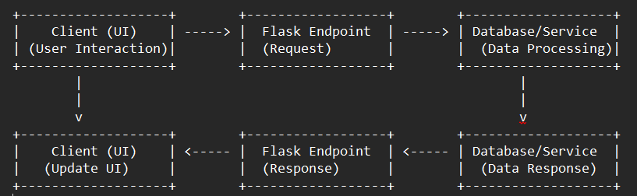
Workflow
Here is the workflow of the system:
The user inputs a book title on the frontend.
The title is sent to the backend through a POST request.
The backend checks the dataset and retrieves similar books using the trained model.
Finally, the recommendations are displayed back on the frontend.

Slide 8
Challenges and Solutions
While developing the project, I faced some challenges:
Dataset quality: The dataset contained some invalid entries, which I handled using preprocessing techniques.
Scalability: With a large dataset, performance could degrade. I optimized the model using efficient algorithms like ball tree.
User experience: I improved the frontend to make it more interactive and responsive.

Slide 9
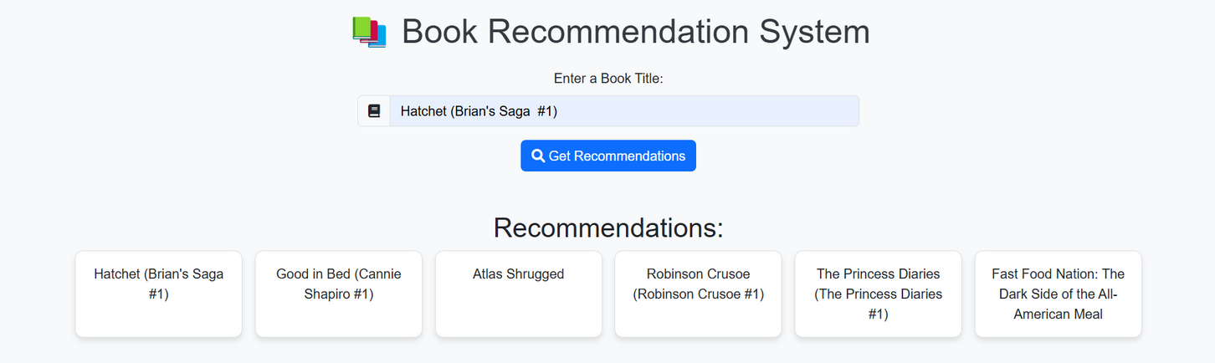
Results and Demonstration
Here are some results:
Inputting 'The Great Gatsby' gives recommendations like 'To Kill a Mockingbird' and '1984'.
The system is responsive and accurate, even for diverse inputs.
Now, I’ll demonstrate the project live to show how it works."

Slide 10
Future Enhancements
This system has potential for further improvements:
Adding a search history feature for users.
Integrating user feedback to refine recommendations.
Expanding the dataset to include more books and genres.
Deploying the application online for public access.

Slide 11
Conclusion
In conclusion, this project demonstrates how machine learning can be combined with web development to solve real-world problems.
It was an enriching experience building a complete system from frontend to backend, and I look forward to expanding its capabilities

Slide 12
THANK
YOU

